Slide 1
Case Study: How secured is your faceprint?
Team-03:
Sai Krishna Prateek Nama - 1001880903
Pratik Dhanraj Chavan - 1001963580
Parth Rajeshkumar Chodvadiya – 1001865625
Notes:
Hello Everyone, We are team-03, our team includes myself Prateek with double e, Pratik with I and Parth. So, our project is a case study on How secured is your Faceprint.

Slide 2
Introduction
Faceprint means a digital scan or photograph of a human face, used for identifying individuals from the unique characteristics of facial structure.
Is FaceID truly safe to use?
Apple claims that 1 in a million chance of possibility to get one’s FaceID match.
Notes:
I know most of know the meaning of Faceprint but let me re-iterate once, So basically, it’s a digital copy of our face’s unique features to identify as an individual.
So, I think most of us use iPhone for its security and this cool feature called faceID as a lock. But is it truly safe to use it? We know there are some exceptional hackers that can bypass anything.

Slide 3
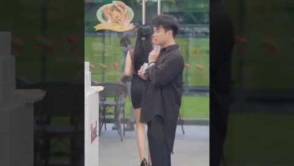
The cool thing with Faceprint
https://www.youtube.com/watch?v=M6ceYSp3RJs
Notes:
Let me show you, this demo video pulled from internet using qFR as payment.

Slide 4
Potential concerns with Faceprint?
Hacking the core software
Impersonating as others
Which one do you think is difficult ?
Both
It depends on system design according to our survey
If you use Apple FaceID, it’s extremely hard to crack from software point of view.
One plus/Samsung Faceprint is extremely easy to crack by just showing an image.
Notes:
That might be funny, but experts think it’s a potential threat.
We have generalized two potential concerns when implementing Faceprint.
Hacking the core software and impersonating as others.
Which one do you think is the easy approach?
It’s both but actually it depends according to our survey.
Let’s go on the strong suit first.

Slide 5
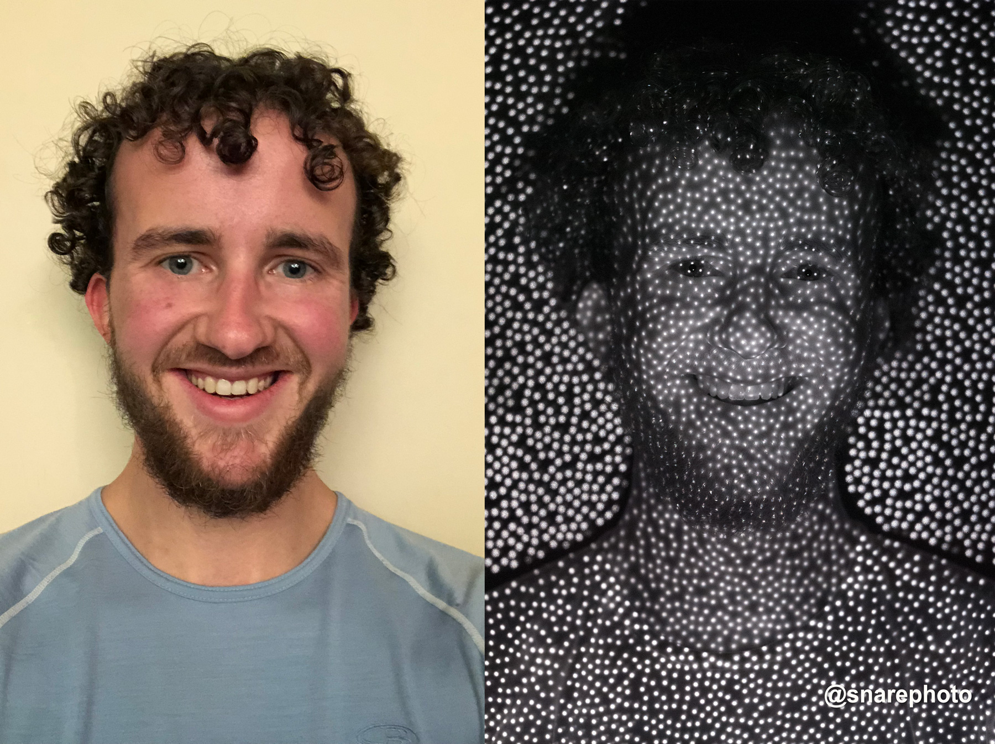
FaceID:
The TrueDepth camera projects and reads over 30,000 infrared dots to form a depth map of the face.
It’s stored as a Mathematical representation. (format is not disclosed by apple)
The researchers discovered a bug in Apple's biometric authentication system's liveness detecting feature, which is used to unlock iPhones using FaceID.
The researchers made a pair of glasses with a white tape frame and a black tape center. The "white spot" was visible to FaceID because of a gap in the black tape. This is sufficient to deceive FaceID and unlock the iPhone.
https://forums.macrumors.com/threads/photo-face-id-infrared-dot-matrix.2084242/
https://tenor.com/view/mission-impossible-mask-gif-18011197
Notes:
So FaceID is one of then state of the art technology which is build in Iphone with a concept called isolated component. So, the FaceID camera is isolated along with it’s processor called Secure enclave and interactive component called memory protection.
When, face is scanned by the FaceID that data is encrypted and sent to memory protection engine for verification that this data is from Camera and then sends to Secure enclave as a mathematical representation.
As you can see in the image it uses over 30,000 IR dot to gather the information.
But surprisingly when iphone released Face ID two group have cracked and bypassed the security feature not by hacking but by fooling the algorithm.

Slide 6
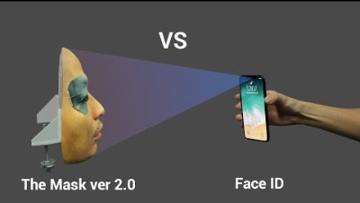
https://www.youtube.com/watch?v=rhiSBc061JU

Slide 7
Windows Hello's facial recognition
Windows Hello is identity verification mechanism that is integrated into the windows 10/11.
Requires a camera with 2 sensor RGB camera and IR camera sensor.
Works with external Camera.
4 Steps involved to Authenticate:
Detects face.
Alignment of face.
Build Mathematical representation of the face.
Compare current representation with enrolled representation.

Slide 8
How can it be exploited?
Construct a real-life 3D model of the enrolled persons face.
Or
Using a simple usb device!
Exploiting using USB device
We earlier saw that windows can use external camera for Windows Hello.
So, we can create a device that will replay the enrolled person's video.

Slide 9
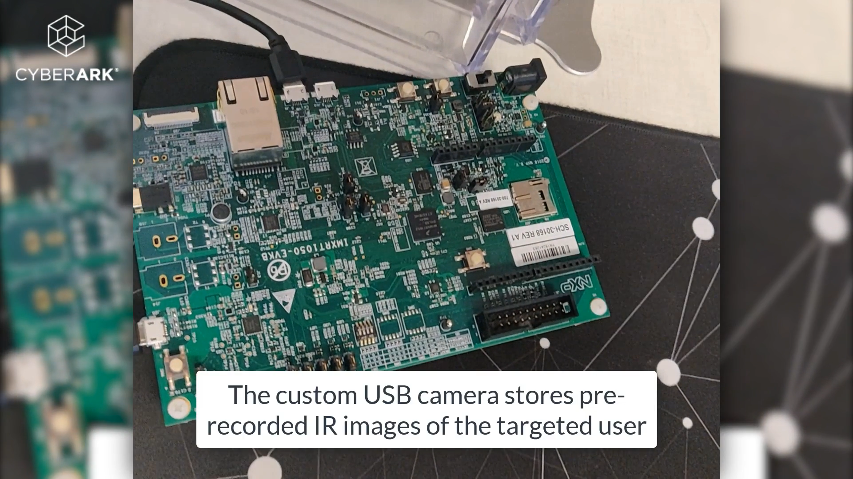
https://www.cyberark.com/resources/threat-research-blog/bypassing-windows-hello-without-masks-or-plastic-surgery

Slide 10
Government Policies
Your data is already in hands of social media platform
Powerful AI and ML algorithms
With my medium end laptop, I was able to create a convincing 3D model using just three 2D images.
Notes:
There are powerful AI and ML algo and software which can identify the uniquely features of the face.
CNN,

Slide 11

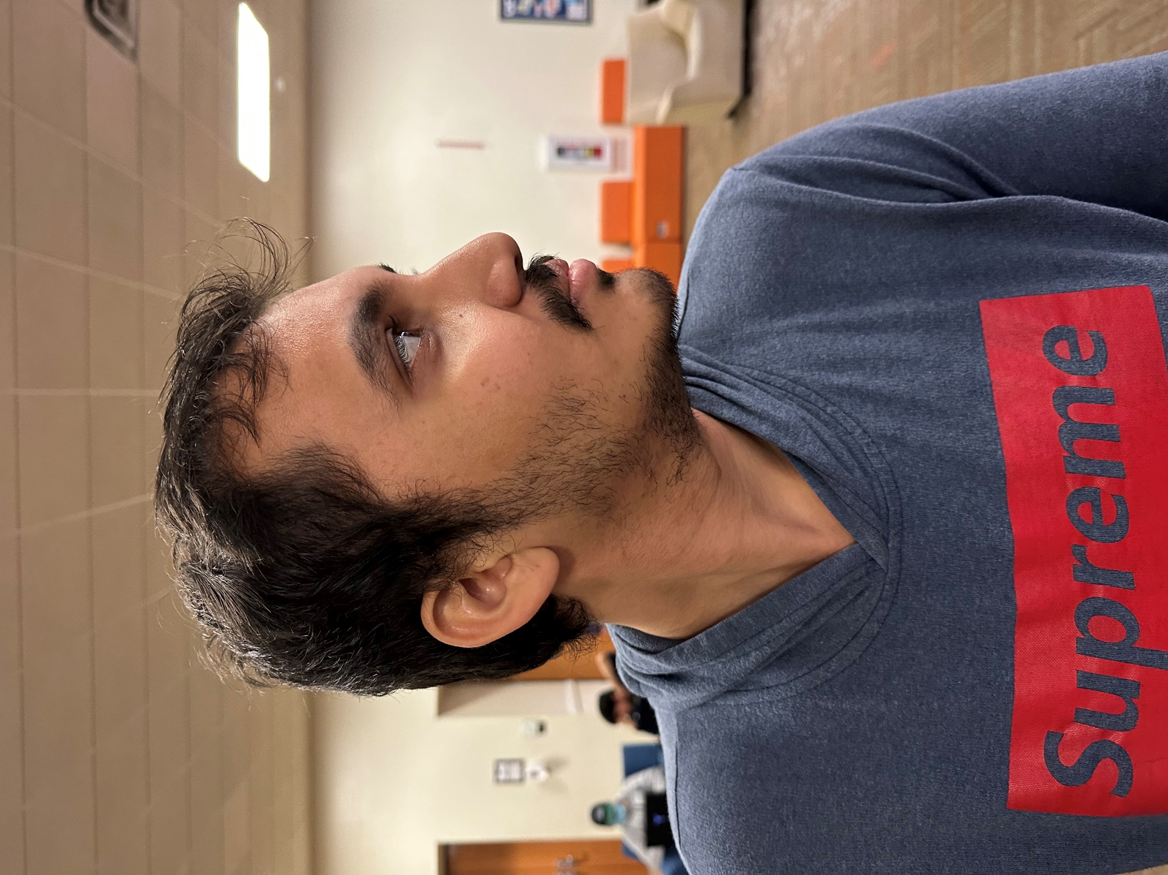
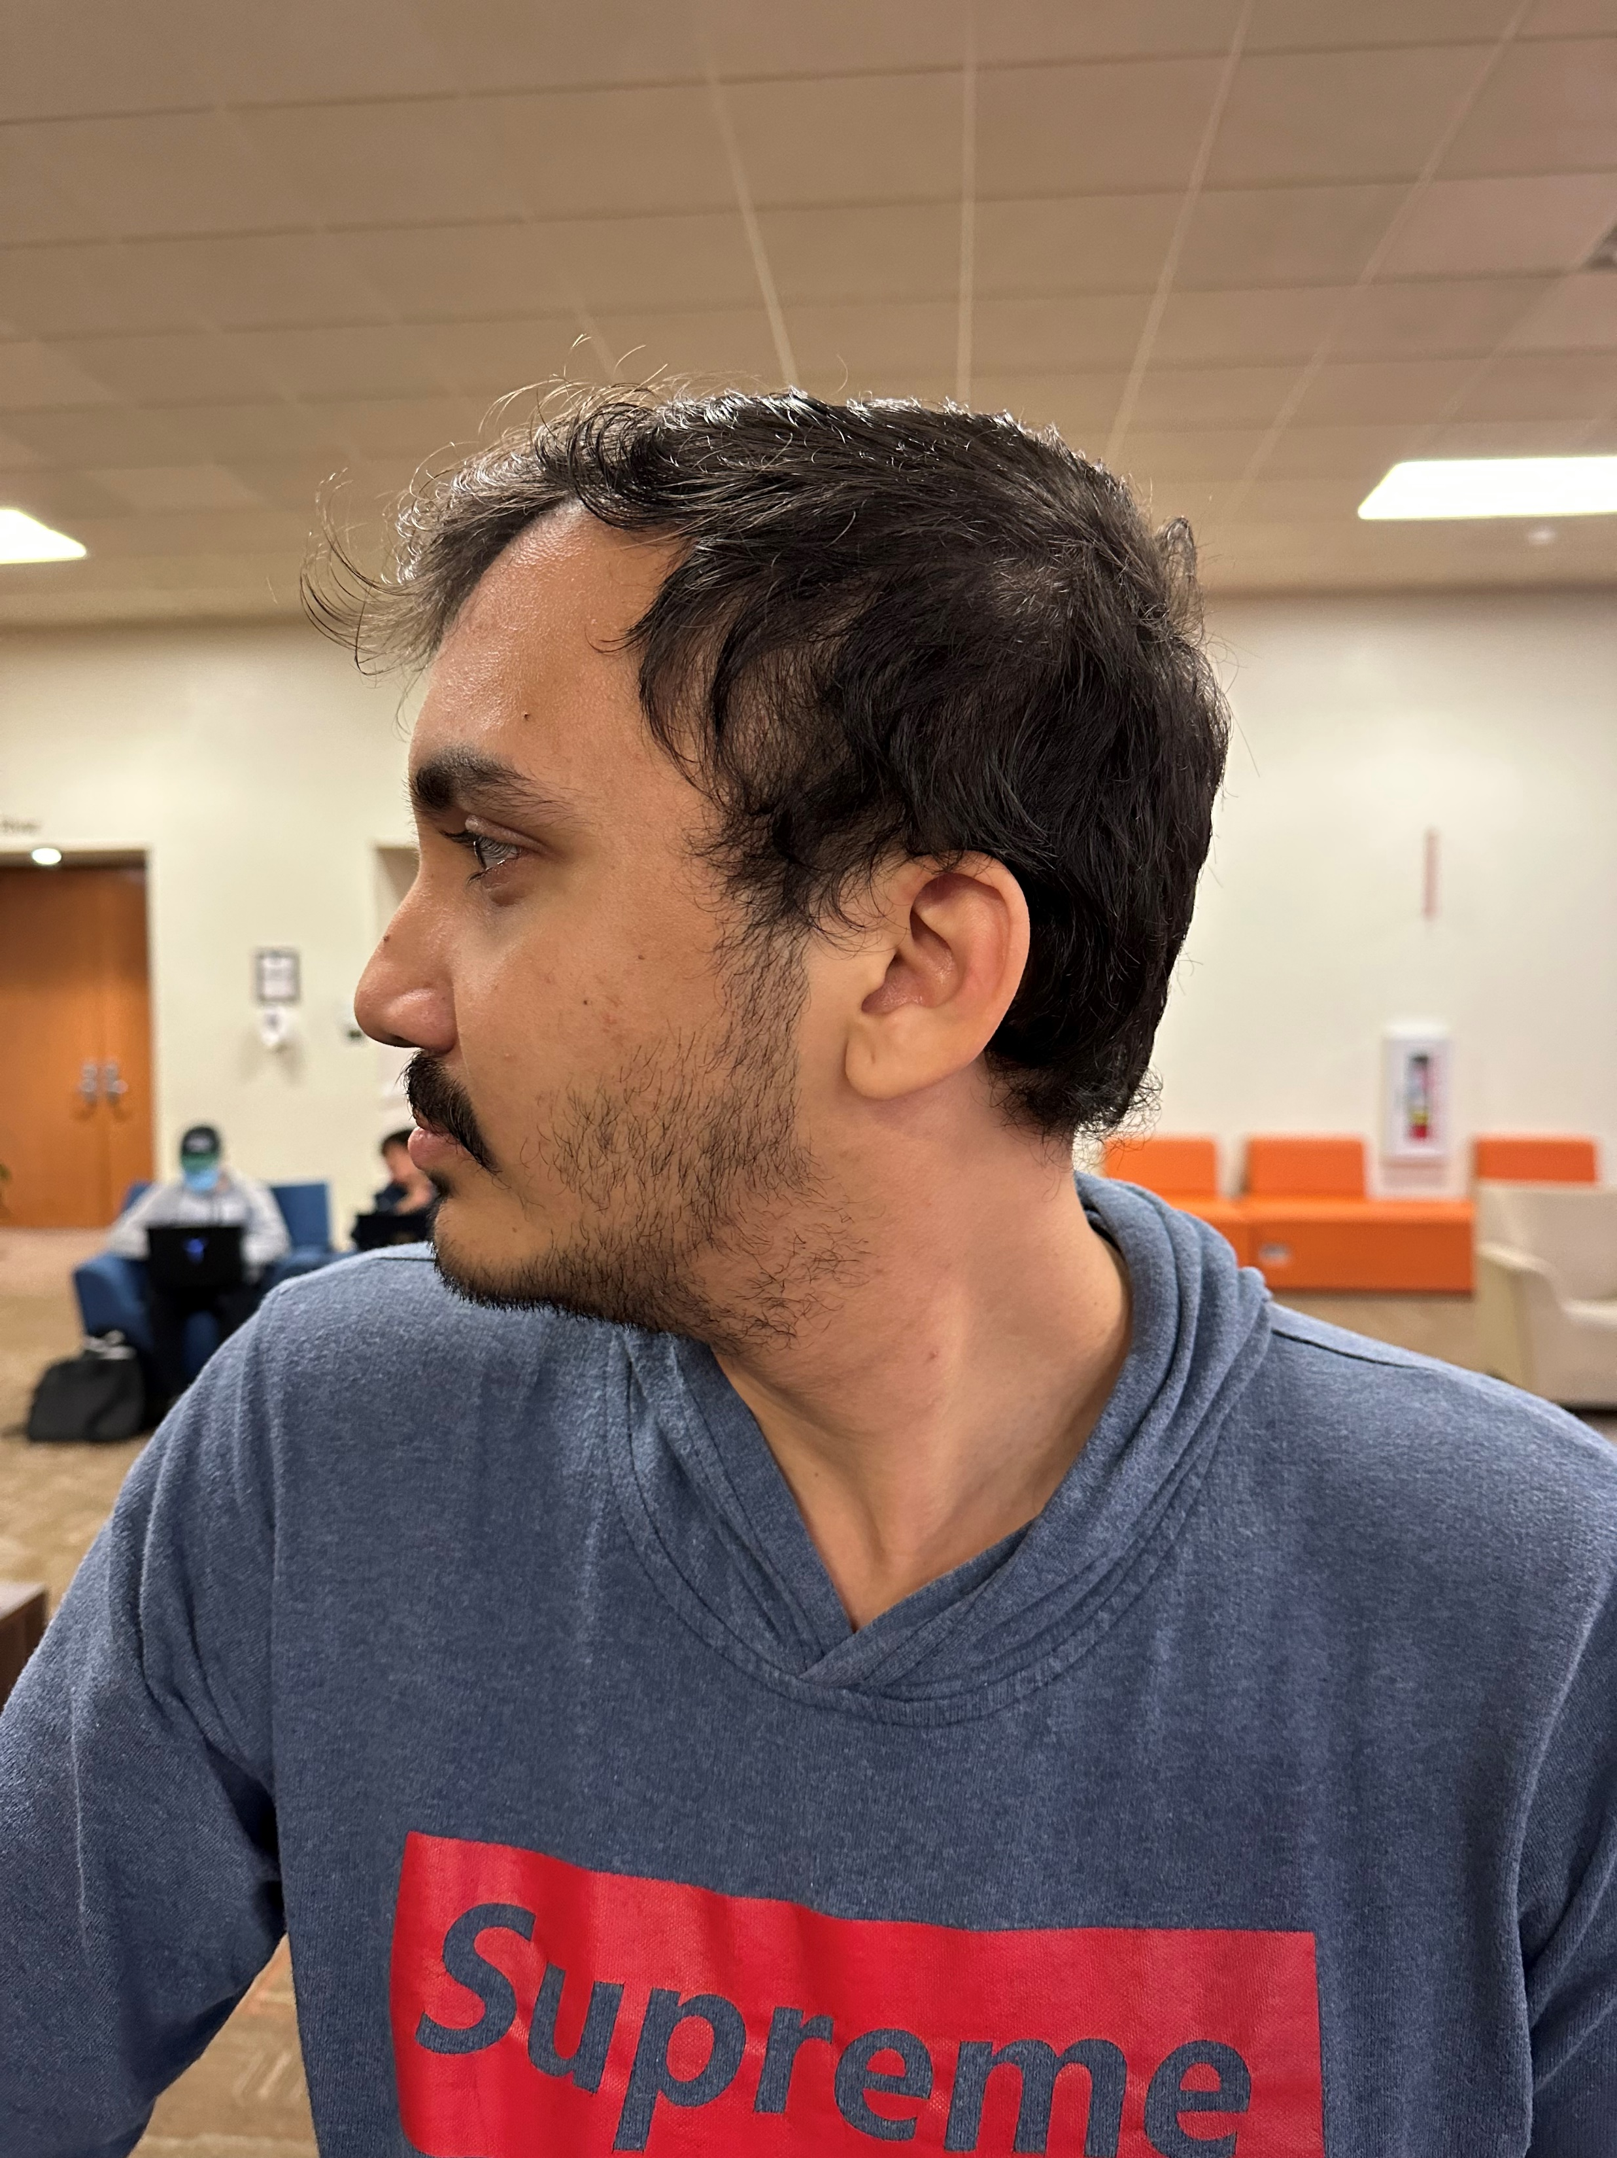
2D Images

Slide 12
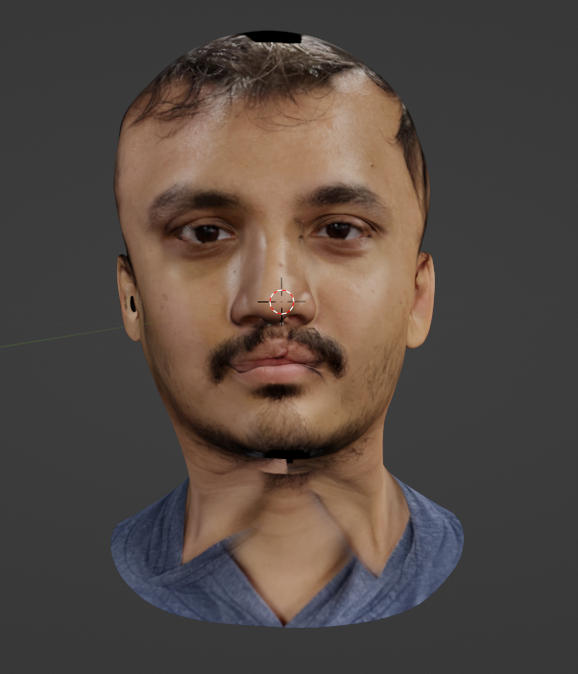
Generated 3D model

Slide 13
Now imagine what these big companies can do with their powerful computing resource?
Facial recognition technology should be accompanied by policies and guidelines
Who sets the policies?
Government sets the policies

Slide 14
Example of using FRT
Facebook
Scanning the faces in uploaded photos to give tag suggestion.
Process was happing in 4 phases
Tries to detect faces in image
Standardized the parameters like orientation and size
Computes the face signature
Searches the signature in stored database to find the matching signature
90 % faces was successfully detected
VS
Australia’s Black Summer bushfires of 2020
FRT was used to recognize the people’s identity.

Slide 15
What did the Government do?
BIPA by Illinois Government
Established the standard for handling biometric data
New York passed the law to ban FRT in school in 2021
Washington State passed the law for not to use FRT without warrant.
Maryland restricted employees to collecting facial data while interviewing a person
California passed a law for Police department, prohibiting the FRT in on body camera
Notes:
There are some steps government took to prevent these kind of behaviour

Slide 16
Conclusion:
Faceprint should be stored locally.
2 most practiced approaches –
RGB sensor.
IR sensor
The IR sensor is more preferable since it can work in different environments with different illumination variance.
Even though apple FaceID has vulnerabilities, but these were addressed and fixed in later version so regular security update will improve the experience.
Unlike other companies, Apple has implemented their faceprint technology independent of other internal hardware makes it unique and robust.
Our Face should not be the only key to access the sensitive information.
It should be paired with something that is unique to you or paired with smart accessories which will act as two factor auth.

Slide 17
References:
https://epic.org/documents/patel-v-facebook/#:~:text=Facebook%20users%20have%20brought%20a,which%20uses%20facial%20recognition%20software
https://support.apple.com/en-us/HT208108
https://www.google.com/url?sa=t&rct=j&q=&esrc=s&source=web&cd=&ved=2ahUKEwimy4mOsun7AhUzm2oFHRtACSwQFnoECAwQAQ&url=https%3A%2F%2Fwww.apple.com%2Fbusiness-docs%2FFaceID_Security_Guide.pdf&usg=AOvVaw2ftLaGSehzviA-uSF9x1ea
https://www.forbes.com/sites/daveywinder/2019/08/10/apples-iphone-faceid-hacked-in-less-than-120-seconds/?sh=60c9621221bc

Slide 18
Android unlock using Image
https://youtube.com/shorts/e_YE7LaM5NQ
Iphone unlock using Image
https://youtube.com/shorts/z5rMbTz6lpI

Slide 19
Thank You!

